Slide 1
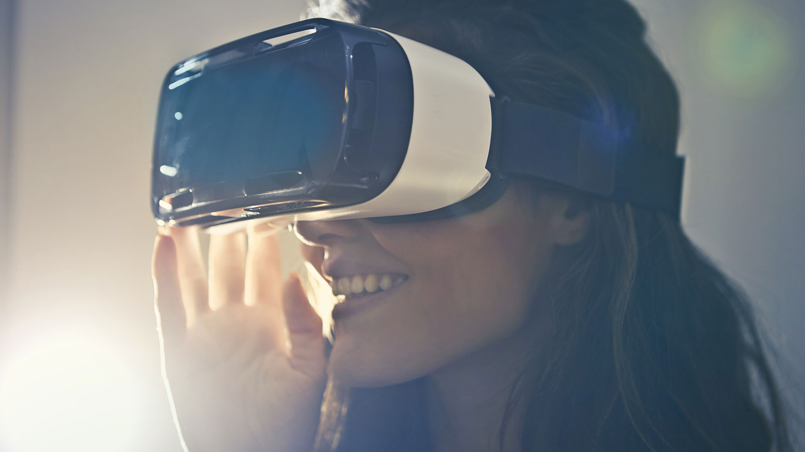
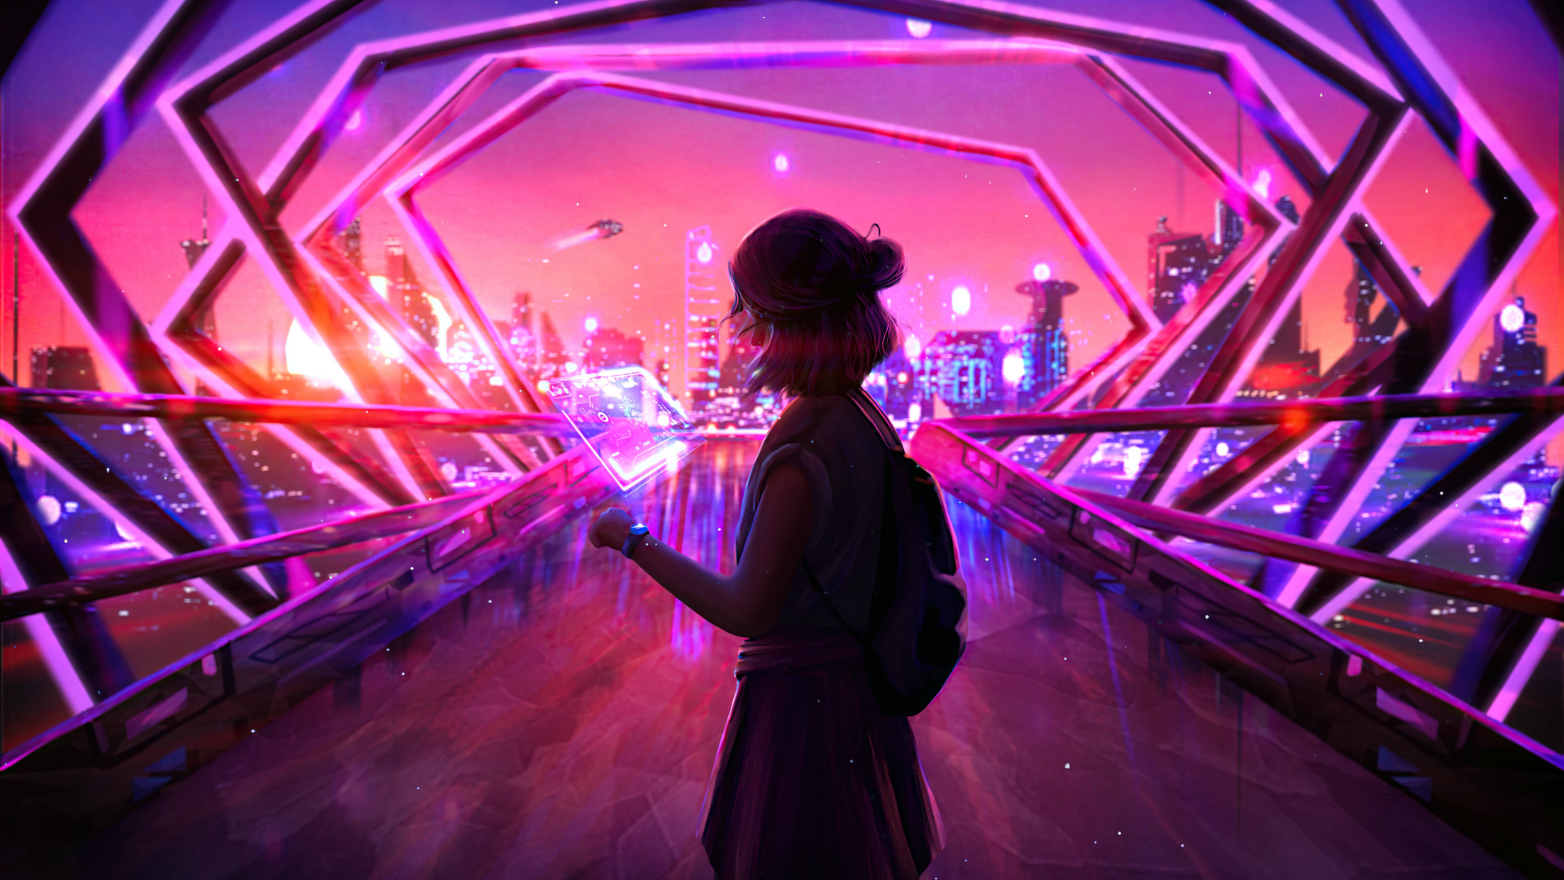
Virtual Reality in Education
Adekunle Grace Dolapo
Unlock a world of immersive experiences that connect learners from every corner of the globe.

Slide 2
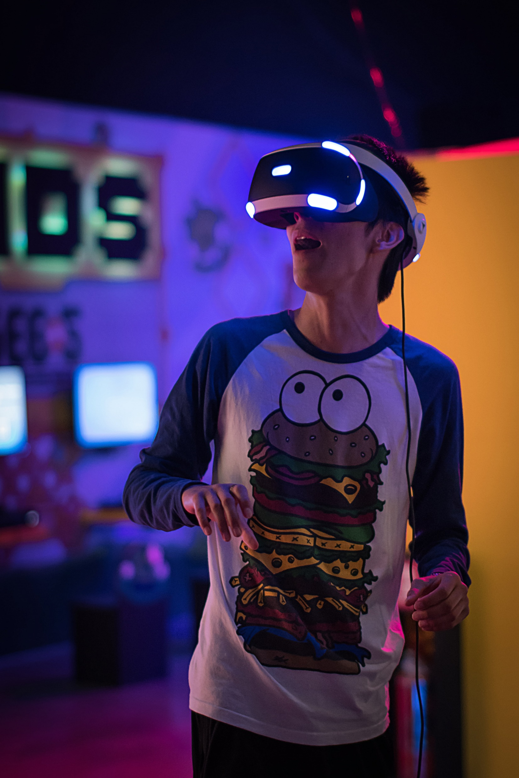
Introduction
Virtual Reality (VR) is a computer-generated environment that lets users immerse themselves in a 3D world, engaging their senses like sight and sound. Think of it as stepping into a whole new reality where you can explore, learn, and interact with virtual objects.
In education, VR brings a world of possibilities, students can tour historical landmarks, perform science experiments safely, or even explore outer space. It turns learning into an exciting, hands-on experience, making complex subjects easier to understand and way more fun!
Incorporating VR in education isn’t just about fun, it boosts engagement, creativity, and memory retention, helping students learn faster and better. Plus, it prepares students for tech-driven industries. Sure, it takes some effort to train teachers and provide the equipment, but the benefits far outweigh the challenges. VR in classrooms is the future, making learning an unforgettable adventure!

Slide 3

Problem Question
How can we increase student engagement and improve learning outcomes by at least 15% through virtual reality (VR) integration across different subjects, fields of study, and grade levels within the next academic year, while minimizing VR-related stress and ensuring at least 80% access to VR equipment?

Slide 4
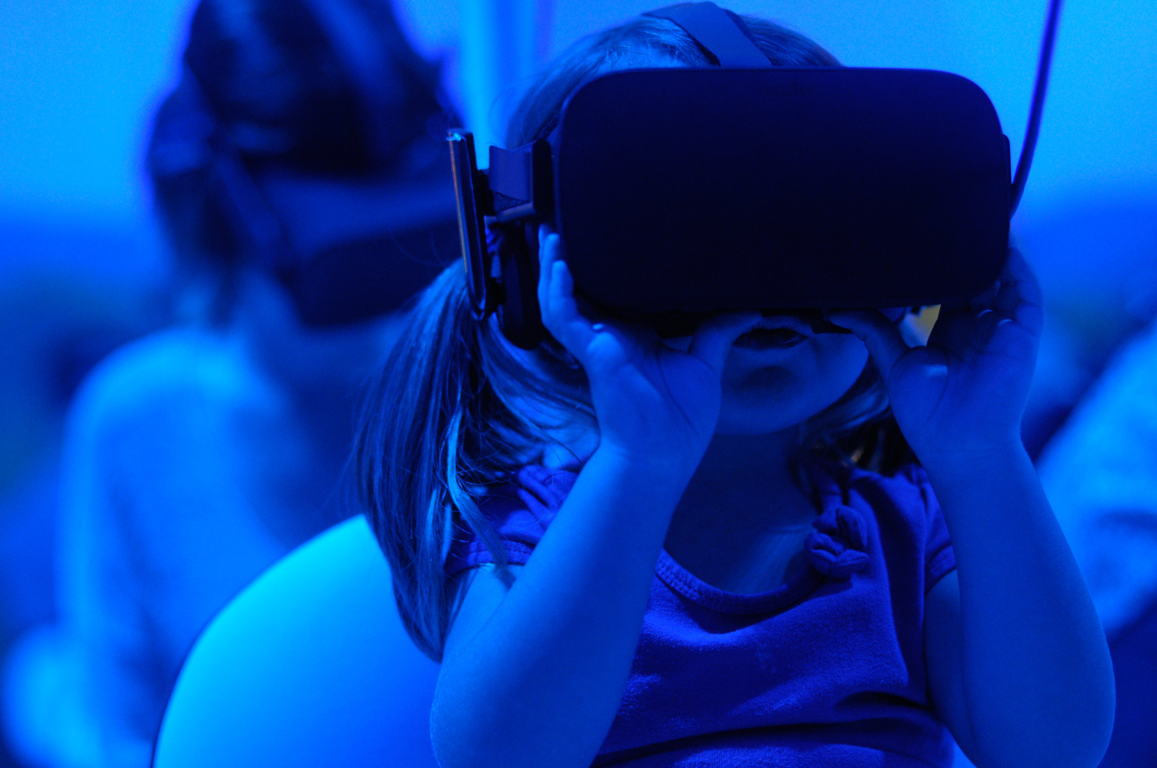
Problem Statement
The integration of virtual reality (VR) into education offers opportunities to enhance student engagement, improve learning outcomes, and foster creativity across various subjects and grade levels. However, challenges such as VR-related stress, limited access to equipment, and varying instructor proficiency hinder its full potential. To address these issues, we aim to improve student engagement and learning outcomes by 15% and ensure at least 80% access to VR tools within the next academic year, while managing stress and encouraging positive collaboration through effective support systems.

Slide 5
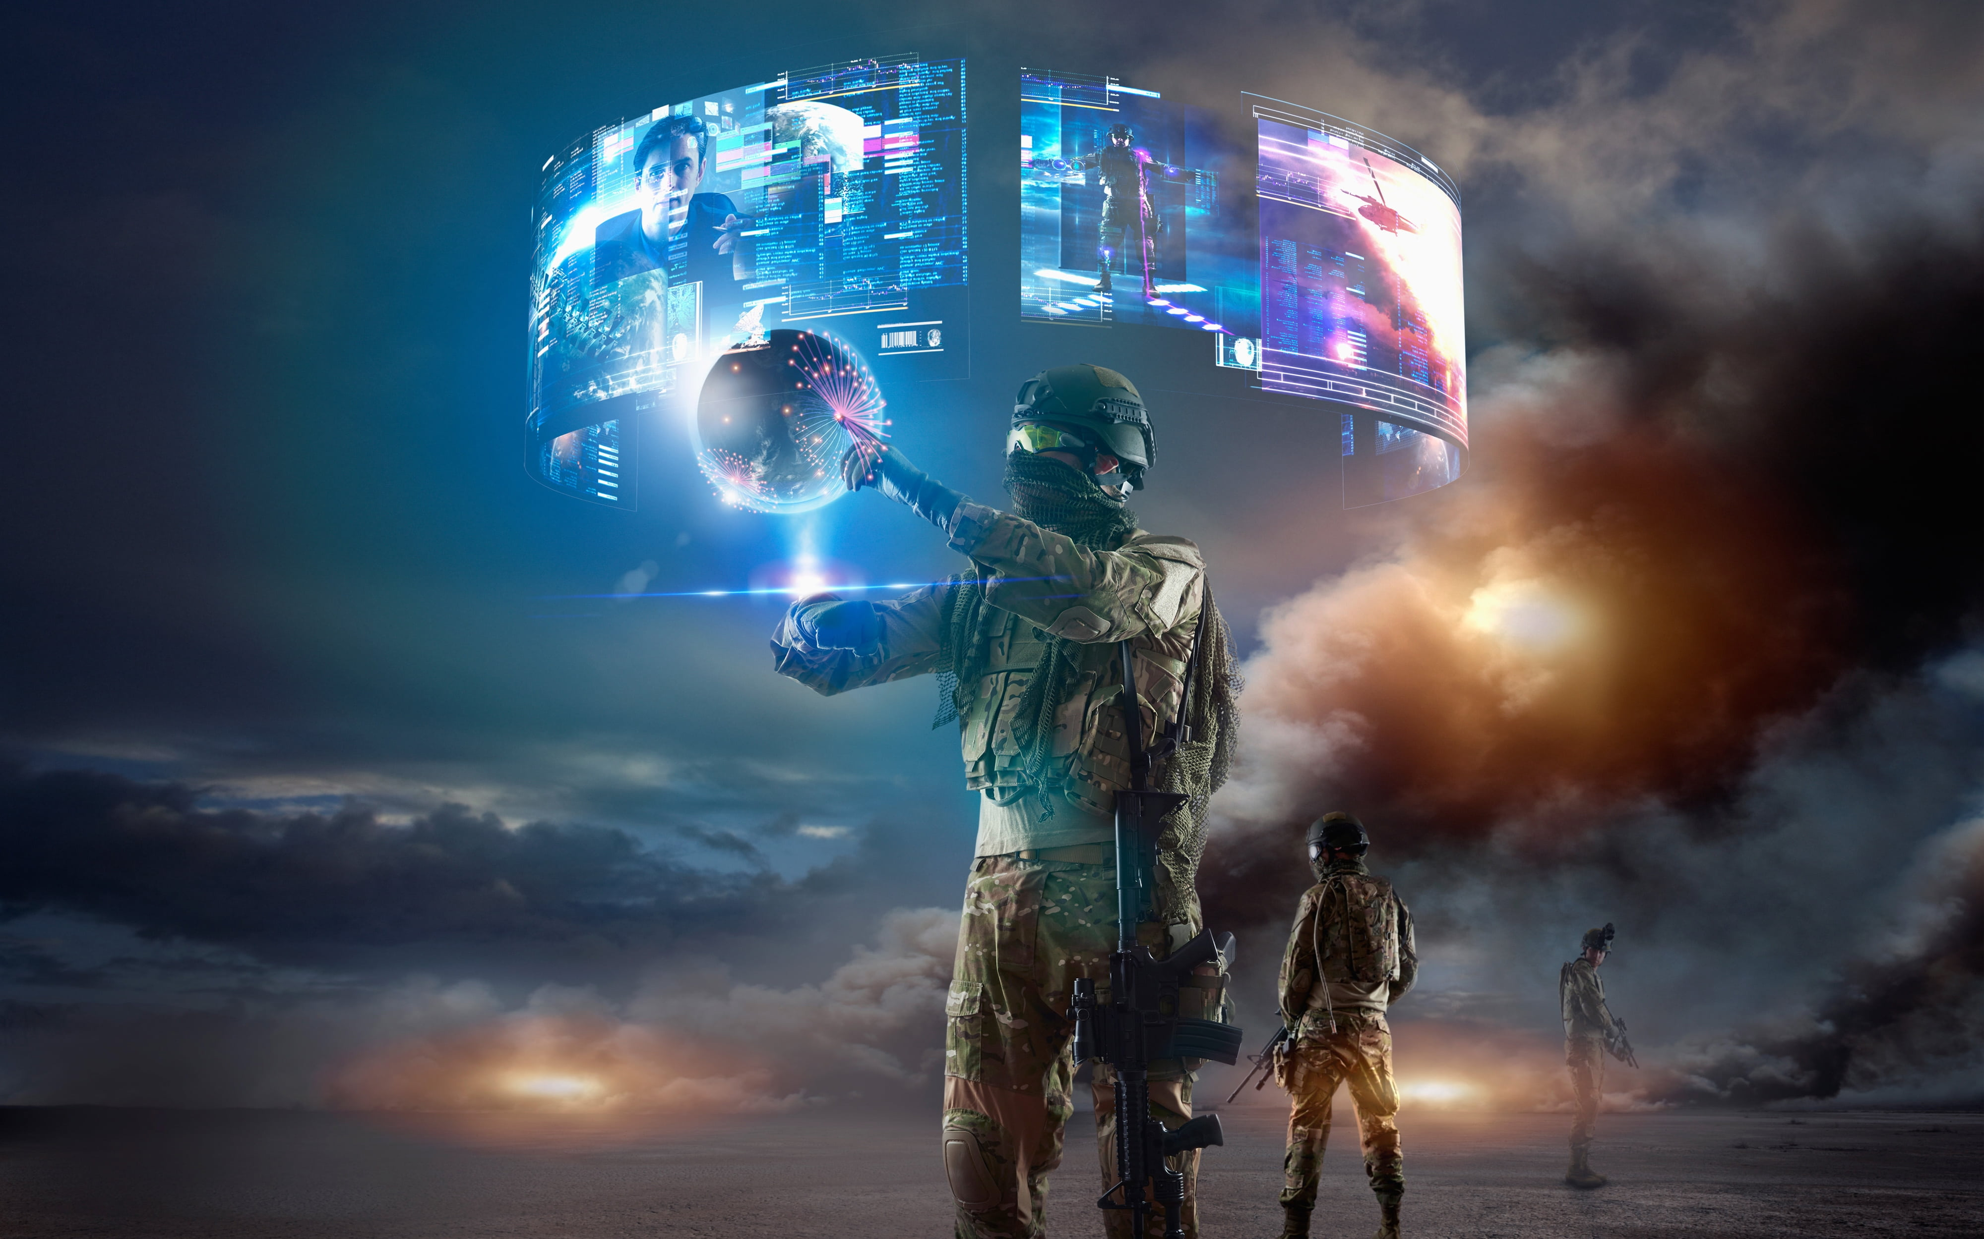
AIM
To enhance student engagement, creativity, and learning outcomes through the effective integration of virtual reality (VR) in education, while ensuring equitable access to VR tonols, minimizing stress, and fostering collaboration among students and educators.

Slide 6
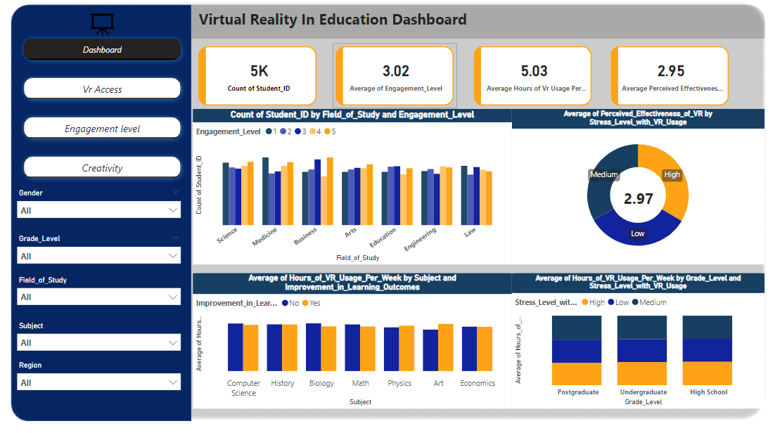

Slide 7
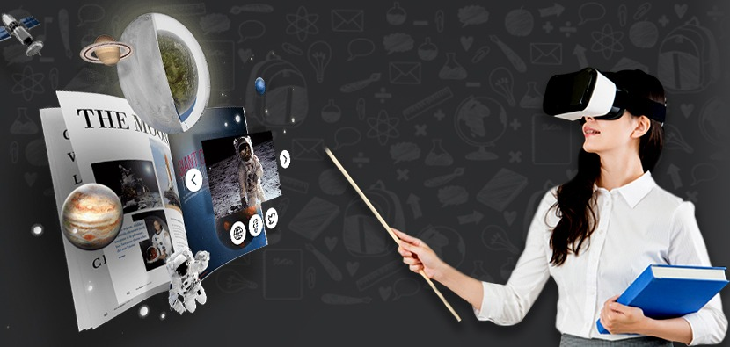
Age Distribution
Students aged 19 to 24 exhibit the highest engagement levels with VR, often reporting better interactions with content and instructors.
As age increases, engagement may slightly decline, indicating that older students (25+) might be more critical of VR applications or less inclined to use new technology in educational settings.
Younger students (under 18) experience different learning outcomes compared to older students, particularly in terms of creativity and hands-on experiences facilitated by VR.
Students aged 19-24 tend to report the most significant improvements in learning outcomes, suggesting that this demographic is both ready and eager to embrace innovative educational tools like VR.
Most students using VR fall in the 19–24 age group, followed by 25–30 years.

Slide 8

Regional Trends
The analysis reveals significant disparities in access to VR tools for educational purposes across South America, Asia, and Oceania. South America and Asia stand out for their proactive approaches to integrating VR technology into their educational systems, driven by investment, government support, and a strong cultural emphasis on education. In contrast, Oceania faces challenges that hinder access to these valuable tools, potentially impacting student engagement and learning outcomes. Addressing these disparities through targeted investment and policy initiatives will be crucial for ensuring that all students can benefit from the advantages of VR in education.
South America and Asia have the highest adoption rates of VR, while Africa and north America show lower adoption rates.

Slide 9
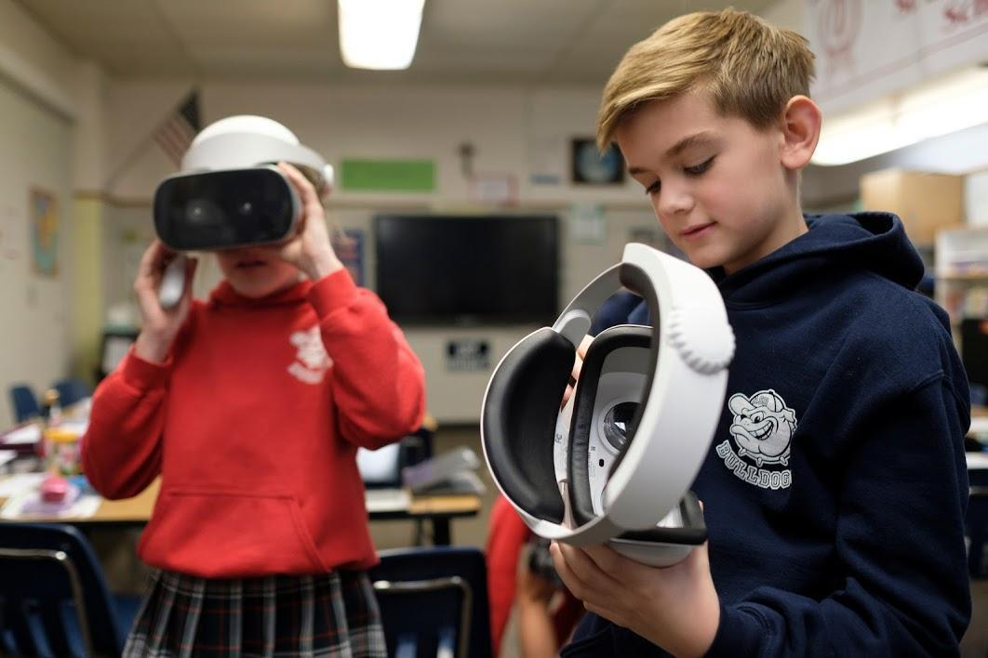
Virtual Reality on Student Engagement
The analysis highlights that students in the Science field tend to spend more time and resources on VR per week compared to their peers in other disciplines. This trend is driven by the hands-on nature of science education, the availability of specialized VR applications, and the engagement that immersive learning experiences provide.
Students studying Science tend to spend more time on Virtual Reality (VR) per week compared to students in other fields of study

Slide 10
Impact on Creativity
The dataset indicates that male students exhibit the highest levels of creativity while using virtual reality (VR) tools, particularly among those in postgraduate programs. This observation highlights the significant impact of VR on fostering creative skills in higher education.

Slide 11
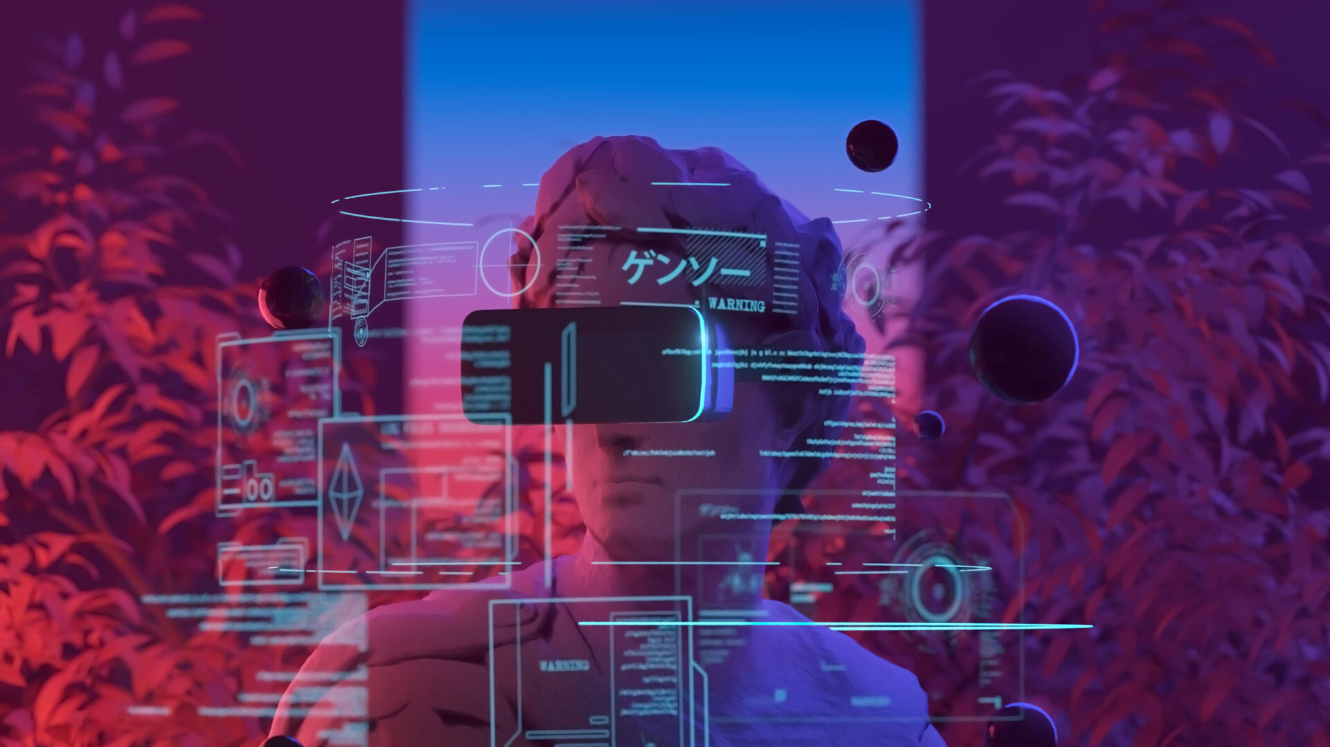
Stress Levels
Art students experience a unique duality in stress levels when using virtual reality (VR) for their educational pursuits, exhibiting both the highest and lowest stress depending on the context of their engagement. While the pressures of creativity and performance can elevate stress levels, VR offers immersive experiences that allow for exploration and expression
Arts students often face unique pressures related to creativity and self-expression.

Slide 12
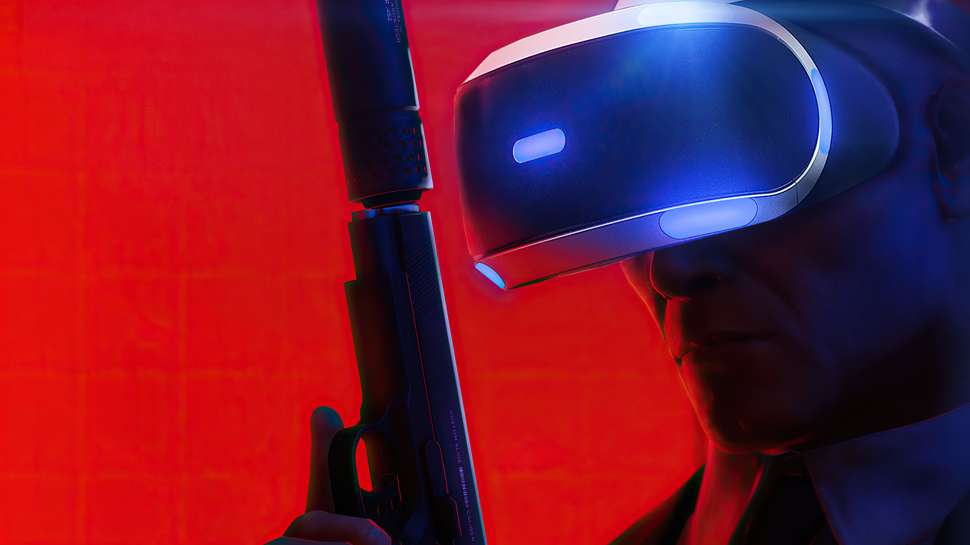
Conclusion
Incorporating virtual reality into education presents an opportunity to transform learning environments, making them more engaging, creative, and supportive for students. However, addressing access disparities and tailoring VR experiences to specific educational needs will be essential for maximizing its benefits.

Slide 13
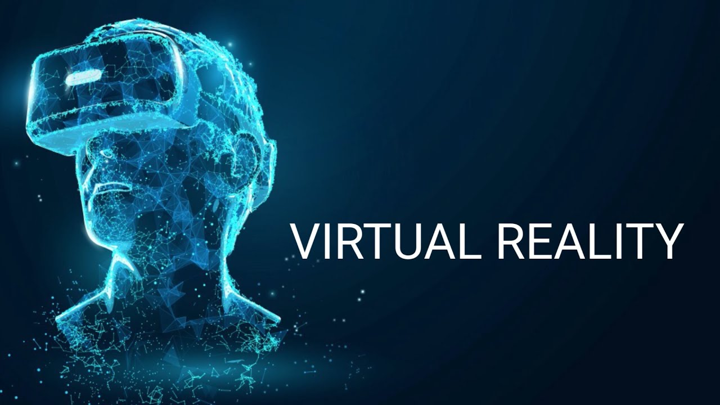
Recommendation
Educational institutions, especially in regions with limited access, should invest in VR technology to ensure all students can benefit from immersive learning experiences.
Training programs should be established for educators to effectively incorporate VR into their teaching methods.
Given VR’s effectiveness in reducing stress, institutions should promote VR as a mental health resource for students.
Schools and universities should integrate VR into their curricula across various subjects, particularly in fields like law and arts, where the benefits are pronounced.

Slide 14
References
Fowler, C. (2015). Virtual Reality in Education: The Future of Learning.
López, F. J., & Blázquez, F. (2020). The Impact of Virtual Reality on Learning Outcomes.
Mikropoulos, T. A., & Natsis, A. (2011). Educational Virtual Environments: A Review of the Literature.

Slide 15
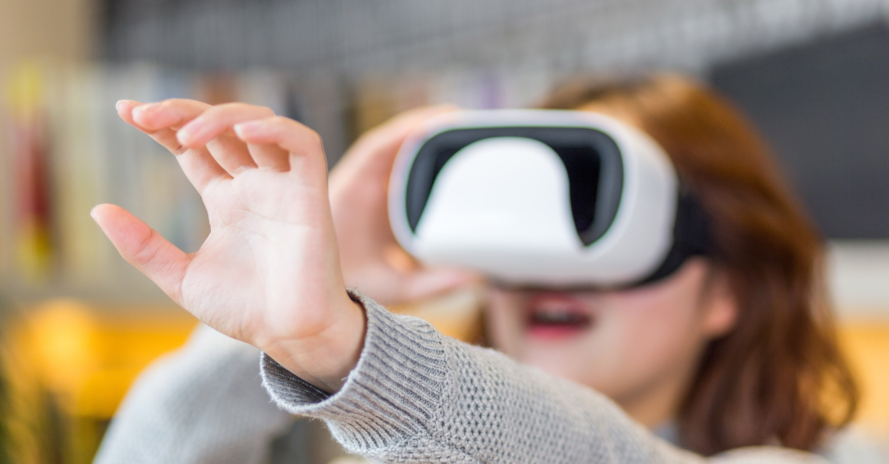
THANK YOU

